Slide 1
Project 4 Temperature and Humidity Control System

Slide 2
Project Description
The aim of this project is to design and implement a system that helps to control temperature and humidity with subsequent responses.
The project uses a Temperature and Humidity sensor, DHT11 to sense any temperature and humidity change on the environment, which uses capacitive humidity sensor and a thermistor to measure the surrounding air and spits out a signal on the data pin.

Slide 3
Components involved
Arduino UNO R3 Board
DHT11
LCD (16x2)
Jumper wires
Resistor(220 ohms)
Potentiometer
Breadboard

Slide 4

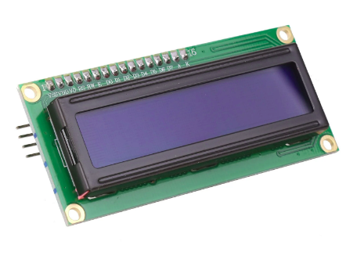
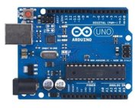
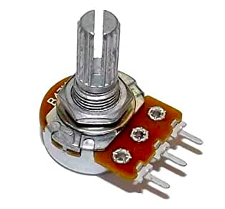
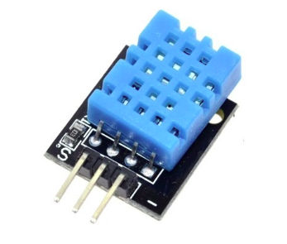
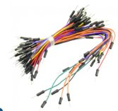
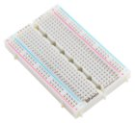
220 ohms
LCD (16x2)
Arduino UNO R3 board
Potentiometer
DHT11
Breadboard
Jumpers

Slide 5
Working principle of DHT11
DHT11 calculates the relative humidity by measuring the electrical resistance between two electrodes.
The humidity sensing component of the DHT11 is a moisture holding substrate with the electrodes applied to the surface.
The change in resistance between two electrodes is proportional to the relative humidity.

Slide 6
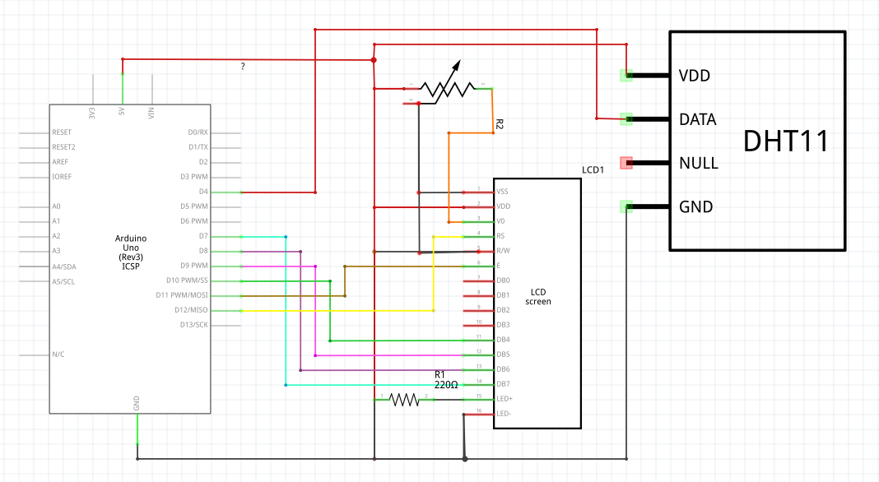
Schematic circuit

Slide 7
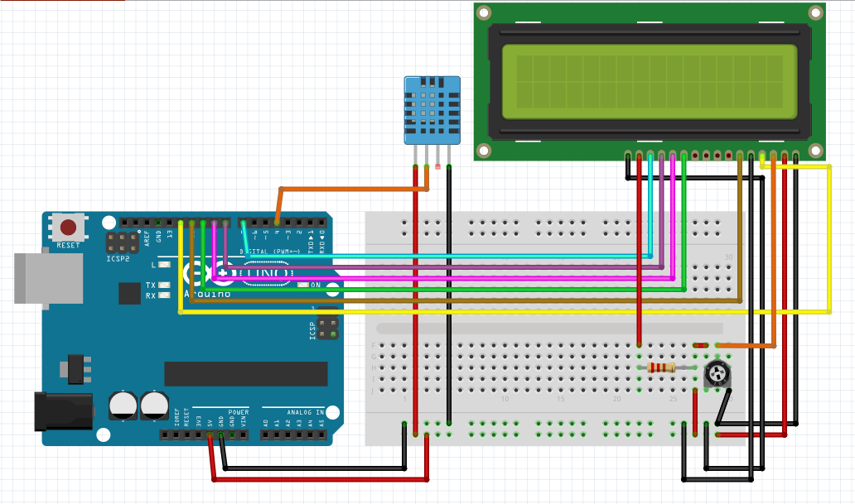
Breadboard Circuit

Slide 8
Applications of the Project
It can be used to controll the electric fan and A/C machines
It can be used in large electrical circuits and systems used in communications that require regular components, devices and system maintanance due to overheating and water vapour
It can be used in weather forecasting

Slide 9


